Slide 1
Pizza Hut Business Analysis using SQL
A Data-Driven Approach to Understanding Sales Trends and Customer Preferences
By Kamlesh Gurunath Pujari

Slide 2

Introduction
This project is based on the sales analysis of Pizza Hut using SQL. The purpose of this project is to understand sales patterns, popular items, and customer preferences. By writing SQL queries, I analyzed different aspects such as total sales, top-selling pizzas, revenue trends, and order frequency. The project helps to show how SQL can be used to manage and analyze real-life business data effectively.

Slide 3
Objective :
Objectives :
The objective of this project is to analyze Pizza Hut’s sales data using SQL to find total orders, revenue, popular and least popular pizzas, sales trends, and category-wise performance, turning raw data into useful business insights.
The main objective of this project is to analyze Pizza Hut’s sales data using SQL and derive meaningful insights. It focuses on measuring total orders, revenue, and price variations of pizzas, along with identifying the most and least popular pizzas and sizes. The project also explores sales trends by time, daily averages, and cumulative revenue, while evaluating category-wise performance and revenue contribution. Overall, it demonstrates how SQL can be used to convert raw data into actionable business insights.

Slide 4
Problem Statements we will dive into :
1. Retrieve the total number of orders placed.
2. Calculate the total revenue generated from pizza sales.
3. Identify the highest-priced pizza.
4. Identify the lowest priced pizza.
5. Identify the most common pizza size ordered.
6. List the top 5 most ordered pizza types along with their quantities.
7. List the top 5 least ordered pizza types along with their quantities. 8. Join the necessary tables to find the total quantity of each pizza category ordered.

Slide 5
9. Determine the distribution of orders by hour of the day.
10. Join relevant tables to find the category-wise distribution of pizzas.
11. Group the orders by date and calculate the average number of pizzas ordered per day.
12. Determine the top 3 most ordered pizza types based on revenue.
13. Calculate the percentage contribution of each pizza type to total revenue.
14. Analyze the cumulative revenue generated over time.
15. Revenue for the date 07-01-2015.
16. Determine the top 3 most ordered pizza types based on revenue for each pizza category.

Slide 6
Queries >

Slide 7
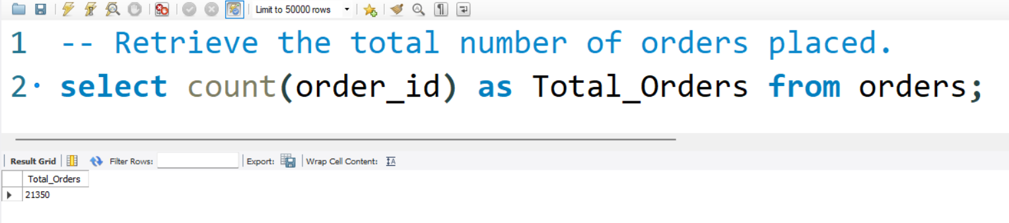
1. Retrieve the total number of orders placed.

Slide 8
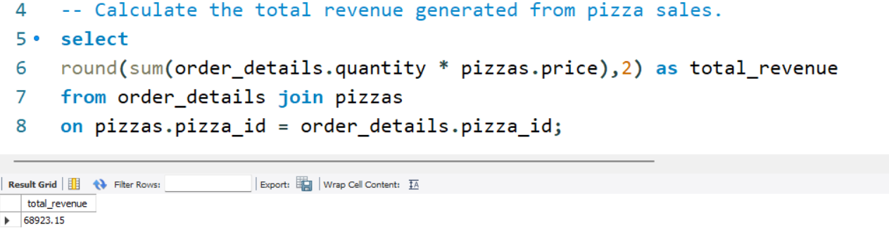
2. Calculate the total revenue generated from pizza sales.

Slide 9
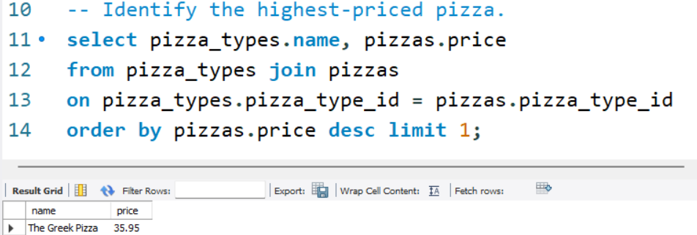
3. Identify the highest-priced pizza.

Slide 10
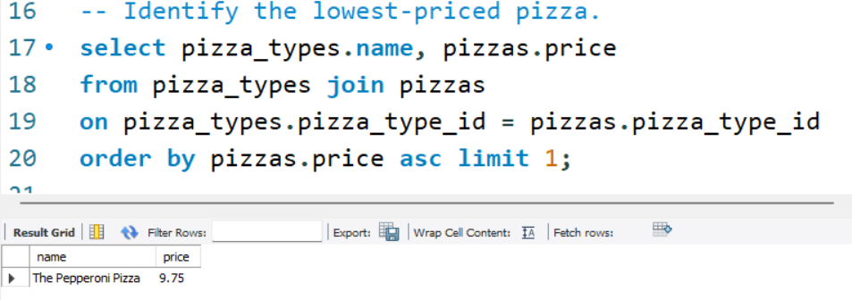
4. Identify the lowest priced pizza.

Slide 11
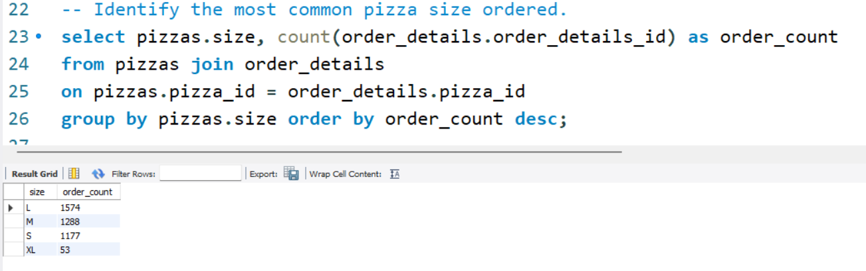
5. Identify the most common pizza size ordered.

Slide 12
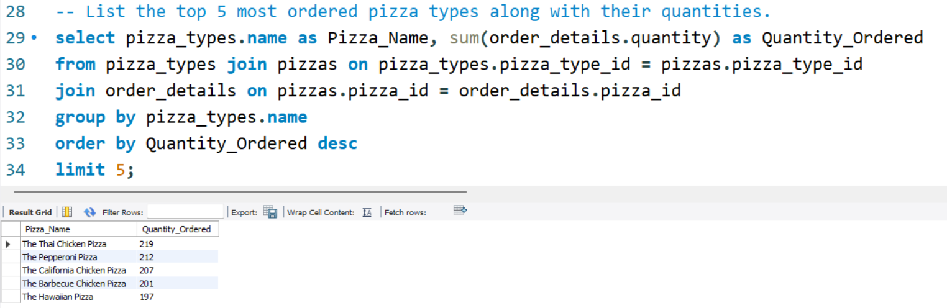
6. List the top 5 most ordered pizza types along with their quantities.

Slide 13
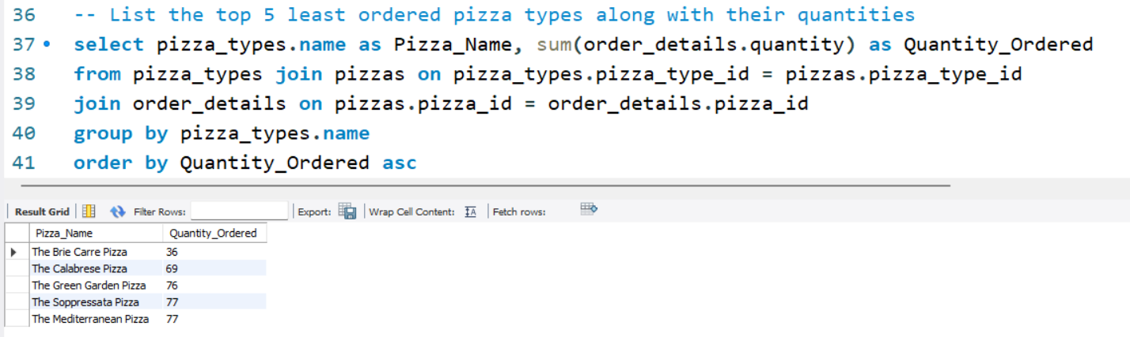
7. List the top 5 least ordered pizza types along with their quantities.

Slide 14
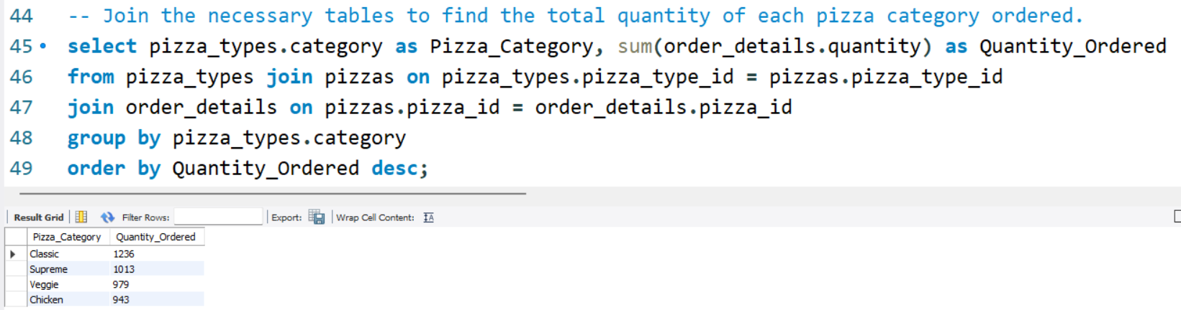
8. Join the necessary tables to find the total quantity of each pizza category ordered.

Slide 15
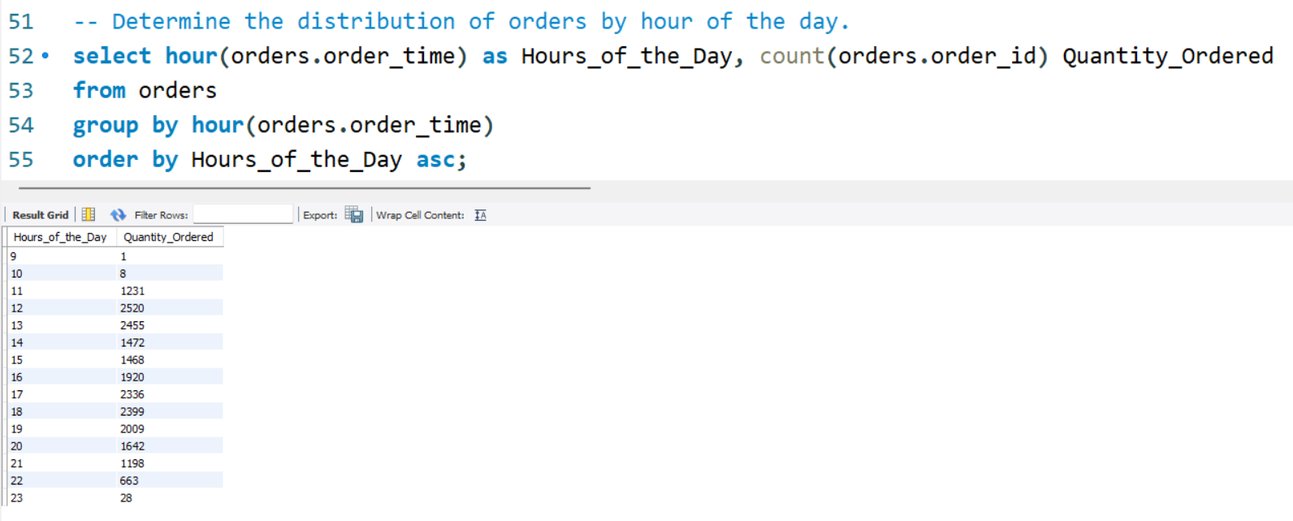
9. Determine the distribution of orders by hour of the day.

Slide 16
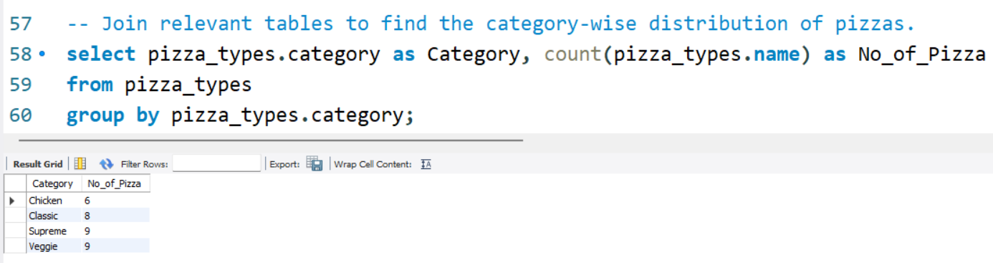
10. Join relevant tables to find the category-wise distribution of pizzas.

Slide 17
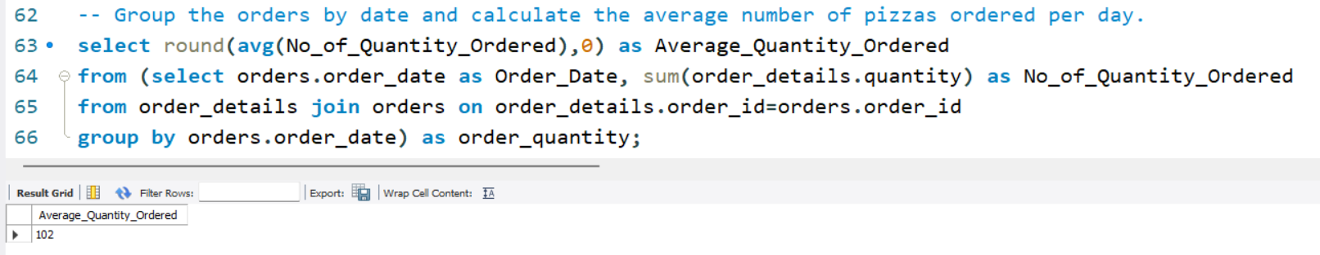
11. Group the orders by date and calculate the average number of pizzas ordered per day.

Slide 18
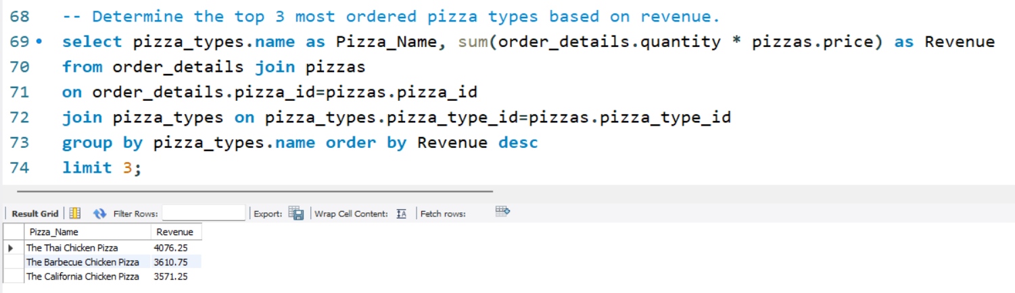
12. Determine the top 3 most ordered pizza types based on revenue.

Slide 19
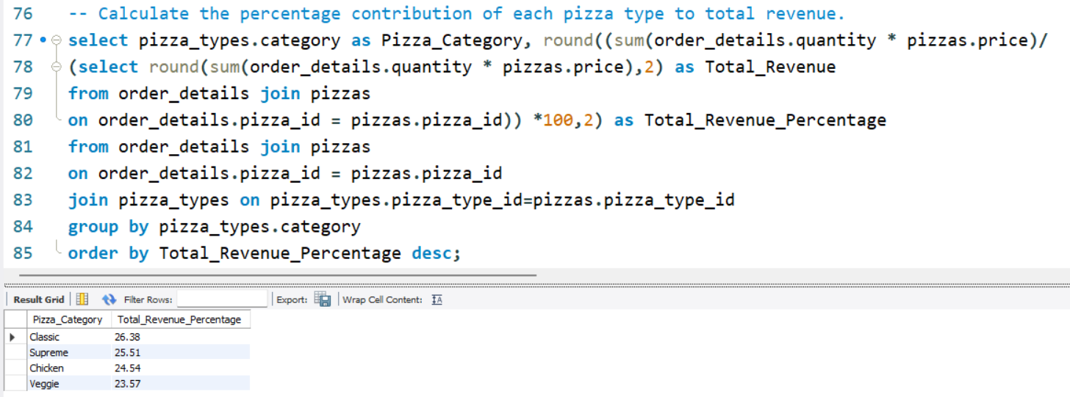
13. Calculate the percentage contribution of each pizza type to total revenue.

Slide 20
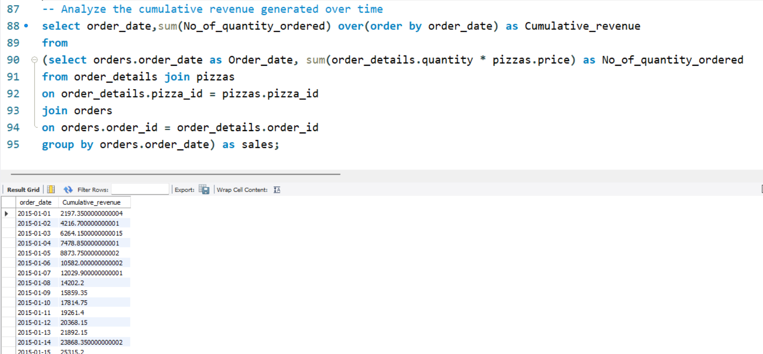
14. Analyze the cumulative revenue generated over time.

Slide 21
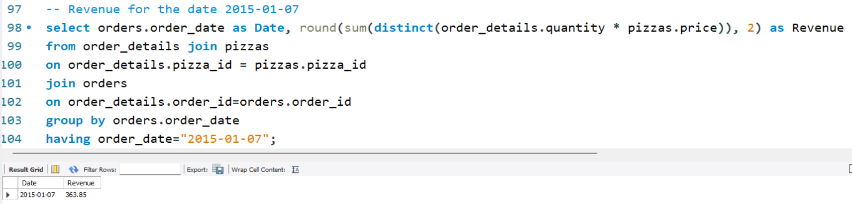
15. Revenue for the date 07-01-2015

Slide 22
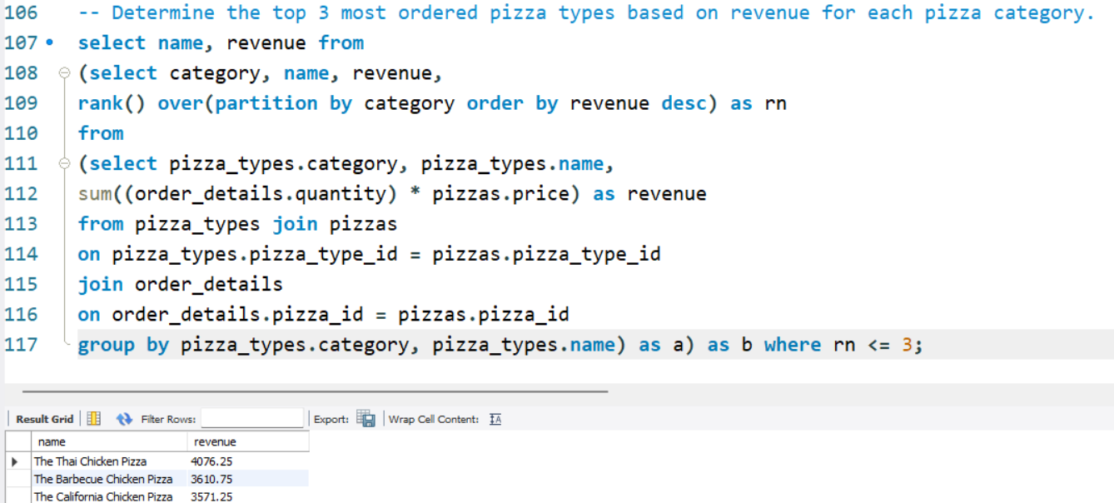
16. Determine the top 3 most ordered pizza types based on revenue for each pizza category.

